Slide 1
Creating & Using SSH Keys on Windows

Slide 2
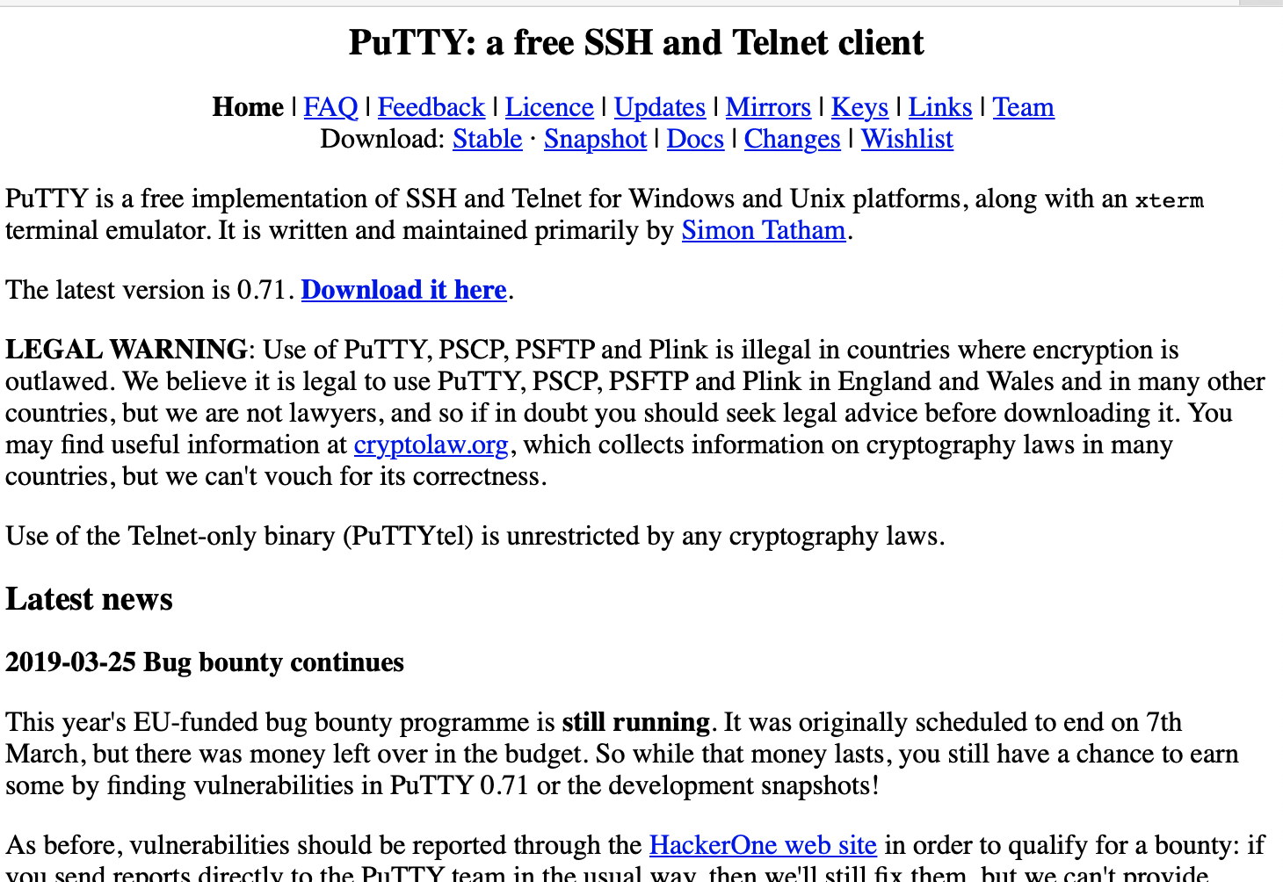
1. Download and Install Putty
https://www.chiark.greenend.org.uk/~sgtatham/putty/

Slide 3
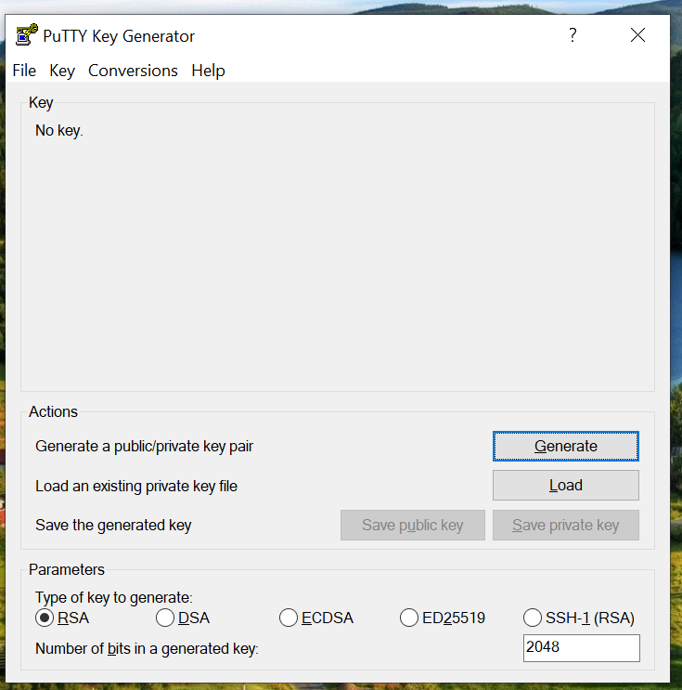
2. Lauch PuttyGen

Slide 4
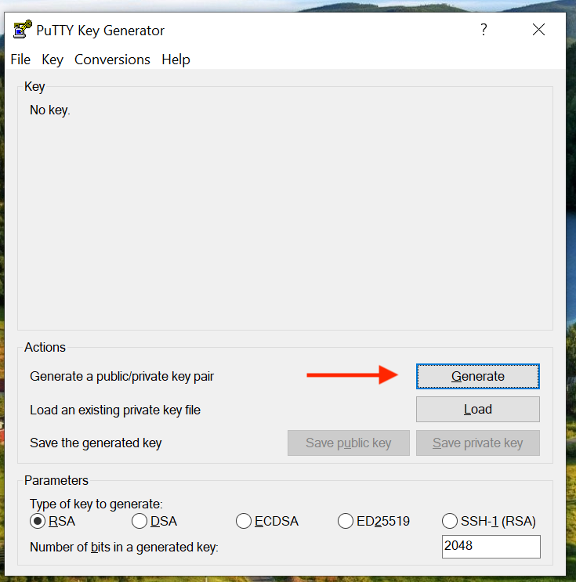
3. Click Generate

Slide 5
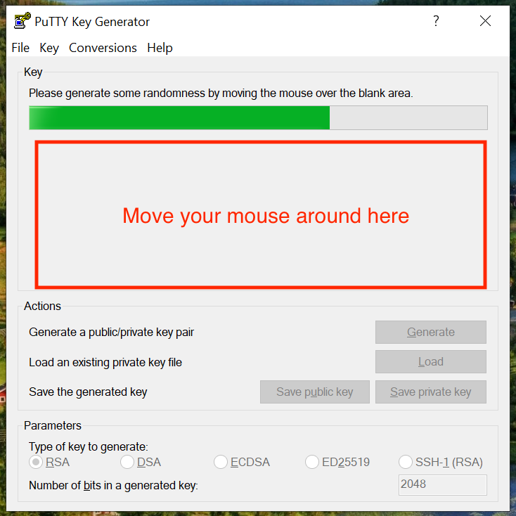
4. Wiggle your Mouse

Slide 6
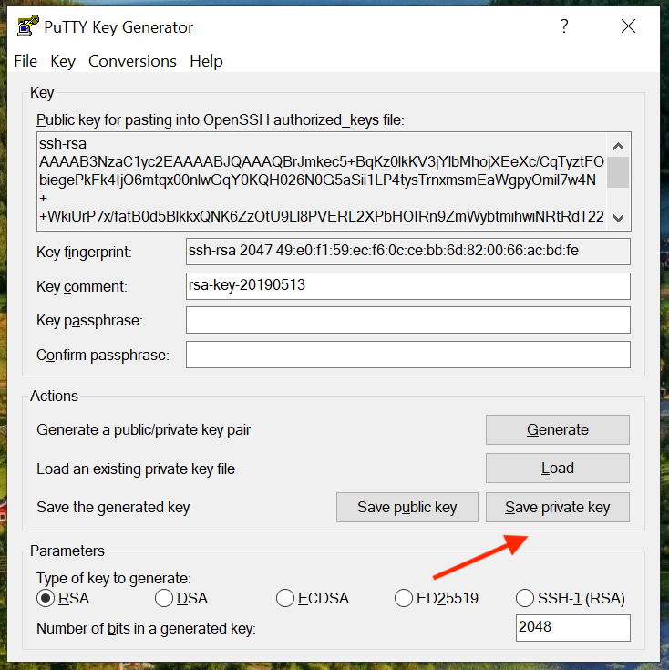
5. Save Your Private Key
Save it anywhere you’d like and
remember the directory we’ll be using it later

Slide 7
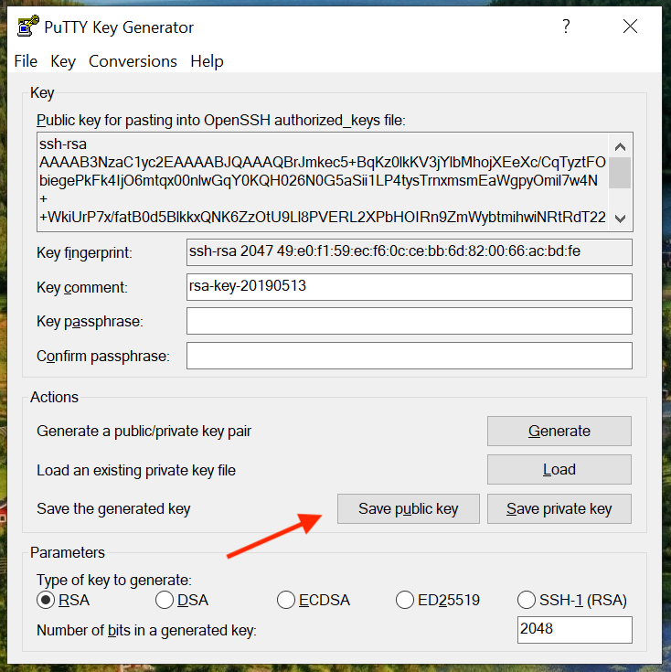
7. Save Your Public Key
Save it anywhere you’d like and
remember the directory we’ll be using it later

Slide 8
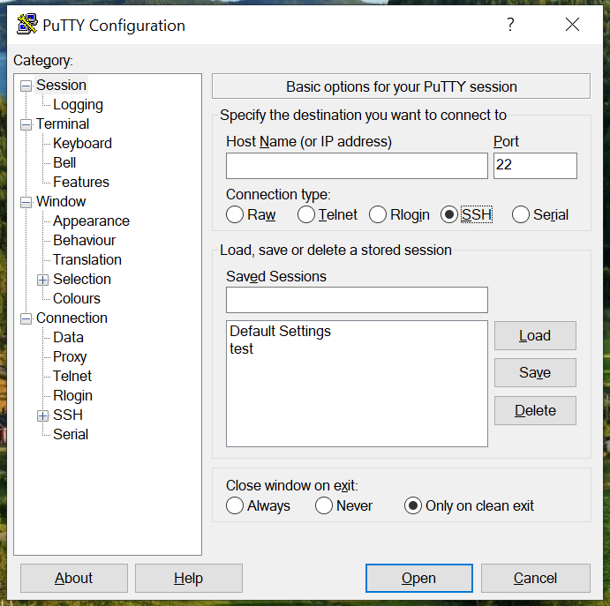
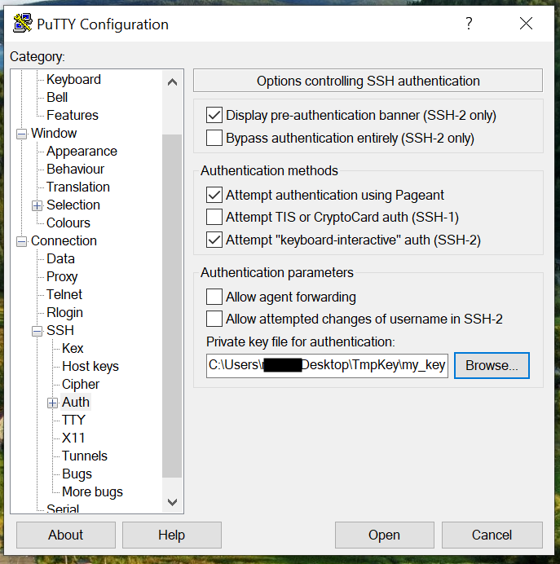
8. Use Your Key Pair in Putty
Open Putty (not PuttyGen)
Add the private key by browsing
to the key you just saved
and open a new connection
Enter IP address of remote machine

Slide 9
Notes
You’ll need to import your public key into AWS in order to access EC2 resources (add it in “Keys” under EC2 portal)
In Step 5, we did NOT save a passphrase with the key; using a passphrase is more secure, but requires you enter the phrase every time you log in
Your public key can be given out freely; that’s why you can safely upload it to AWS
Keep your private key safe on your local system

